Slide 1

Chapter 4
Managing Software

Slide 2
dpkg
Think .msi file in Windows
Made up of multiple parts
Configuration files
Binaries
Pre- and post execution scripts
Used to install/remove/package software
Maintains a local database of installed packages

Slide 3
common dpkg commands
Install “package-name.dpkg” $ sudo dpkg -i /path/to/package-name.dpkg
Remove “package-name” (uninstall) $ sudo dpkg –r package-name
List of packages and their state $ sudo dpkg -l $ sudo dpkg -l “package*”

Slide 4
apt (advanced packaging tool)
apt is a set of tools
leverages dpkg to do the actual installations
apt uses “repositories” to install packages
apt downloads packages and uses dpkg to install
applies system and software updates
apt also handles dependency management

Slide 5
common apt commands
Install “package-name” $ sudo apt install package-name
Remove “package-name” $ sudo apt remove package-name
Update the local database $ sudo apt update
Upgrade our system and software $ sudo apt upgrade

Slide 6
repos
Collection of software for a linux distribution
Remember, linux only refers to the kernel
Usually located on the Internet
You can host your own
Configured by default when you install your distro
/etc/apt/sources.lst = main apt repository list

Slide 7
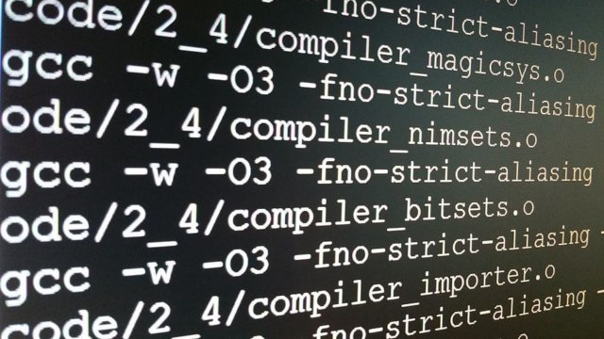
compiling software
The ‘soul’ of open source is providing access to source code
You have the ability to modify the software to meet your needs
Why compile when apt and dpkg are easier?
Uncommon architecture
Custom install location
Compiled software needs manual updating
Not in apt or dpkg database

